Slide 1








TRIP EFFICIENCY STRATEGY
Based on January 2023 Data
Presented By:
Alfriando C Vean
NYC TLC Strategic Planning Team
as
Visit Our Website
NYC TLC

Slide 2

OUTLINE
Background
Data
Analysis
Business Recommendations
2

Slide 3

BACKGROUND

Slide 4


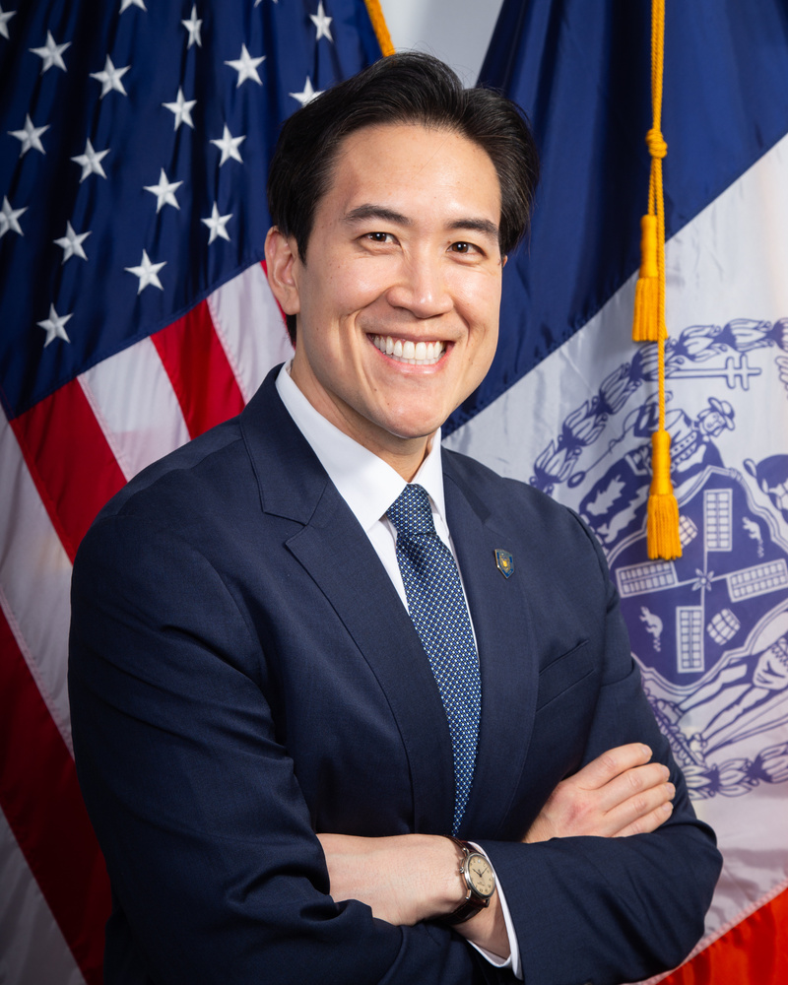

BACKGROUND
Company Profile
The New York City Taxi and Limousine Commission (TLC), created in 1971, is the agency responsible for licensing and regulating New York City's Medallion (Yellow) taxi cabs, for-hire vehicles (community-based liveries, black cars and luxury limousines), commuter vans, and paratransit vehicles.
Our Commisioner Profile
David Do
Confirmed by the City Council to serve as Commissioner and Chair of the New York City Taxi and Limousine Commission (TLC) on May 19, 2022.
3
Source: NYC TLC-Leadership

Slide 5



BACKGROUND
Mission
To ensure that New Yorkers and visitors to the City have access to taxicabs, car services, and commuter van services that are safe, efficient, sufficiently plentiful, and provide a good passenger experience
Vision
To create a modern, safe, and equitable transportation system by promoting innovation, protecting consumers, supporting drivers, and ensuring mobility access for all
4

Slide 6



BACKGROUND
Problems
Even in NYC’s high-mobility landscape, uneven distribution of taxi supply still persists. This spatial imbalance results in:
Idle fleet time
Taxis spend more time waiting than moving
Underserved Area
High-demand areas suffer from slow response and long wait times
Missed Revenue Opportunities
Vendors lose potential earnings due to inefficient deployment
5

Slide 7


BACKGROUND
Objectives
Reduce passenger wait time by up to 5 minutes in key zones within 1 month
Increase vendor revenue by 3–5% in underutilized areas through better fleet placement
Identify opportunities to increase off-peak ridership by 10% through incentive-based strategies within 1 month
6

Slide 8
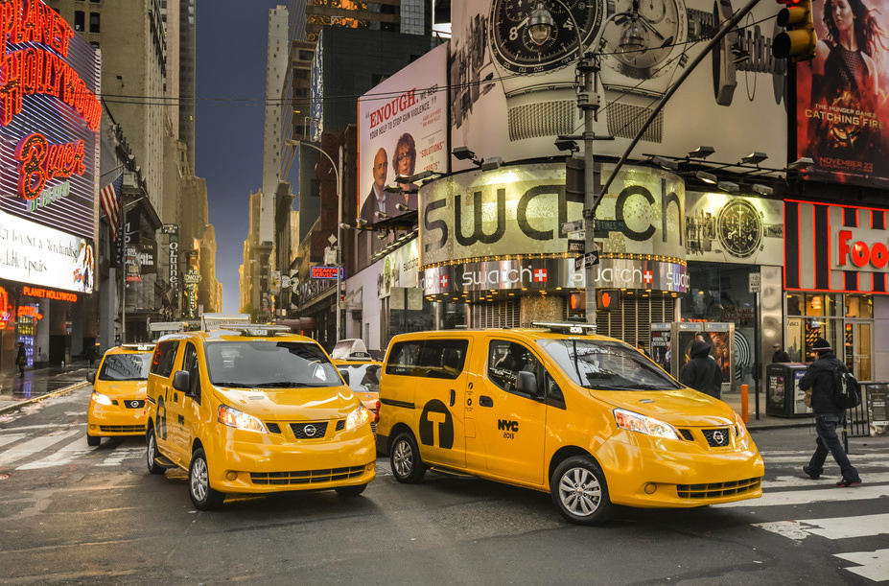
DATA

Slide 9


DATA
Dataset Overview
NYC TLC Trip Data
NYC TLC Location Data
Merge
Data Cleaning
(Duplicated Data, Missing Data, Anomaly Data)
Completed Data
Period : January 2023
Records : 62409 rows
Features : 27 columns
7

Slide 10

ANALYSIS

Slide 11
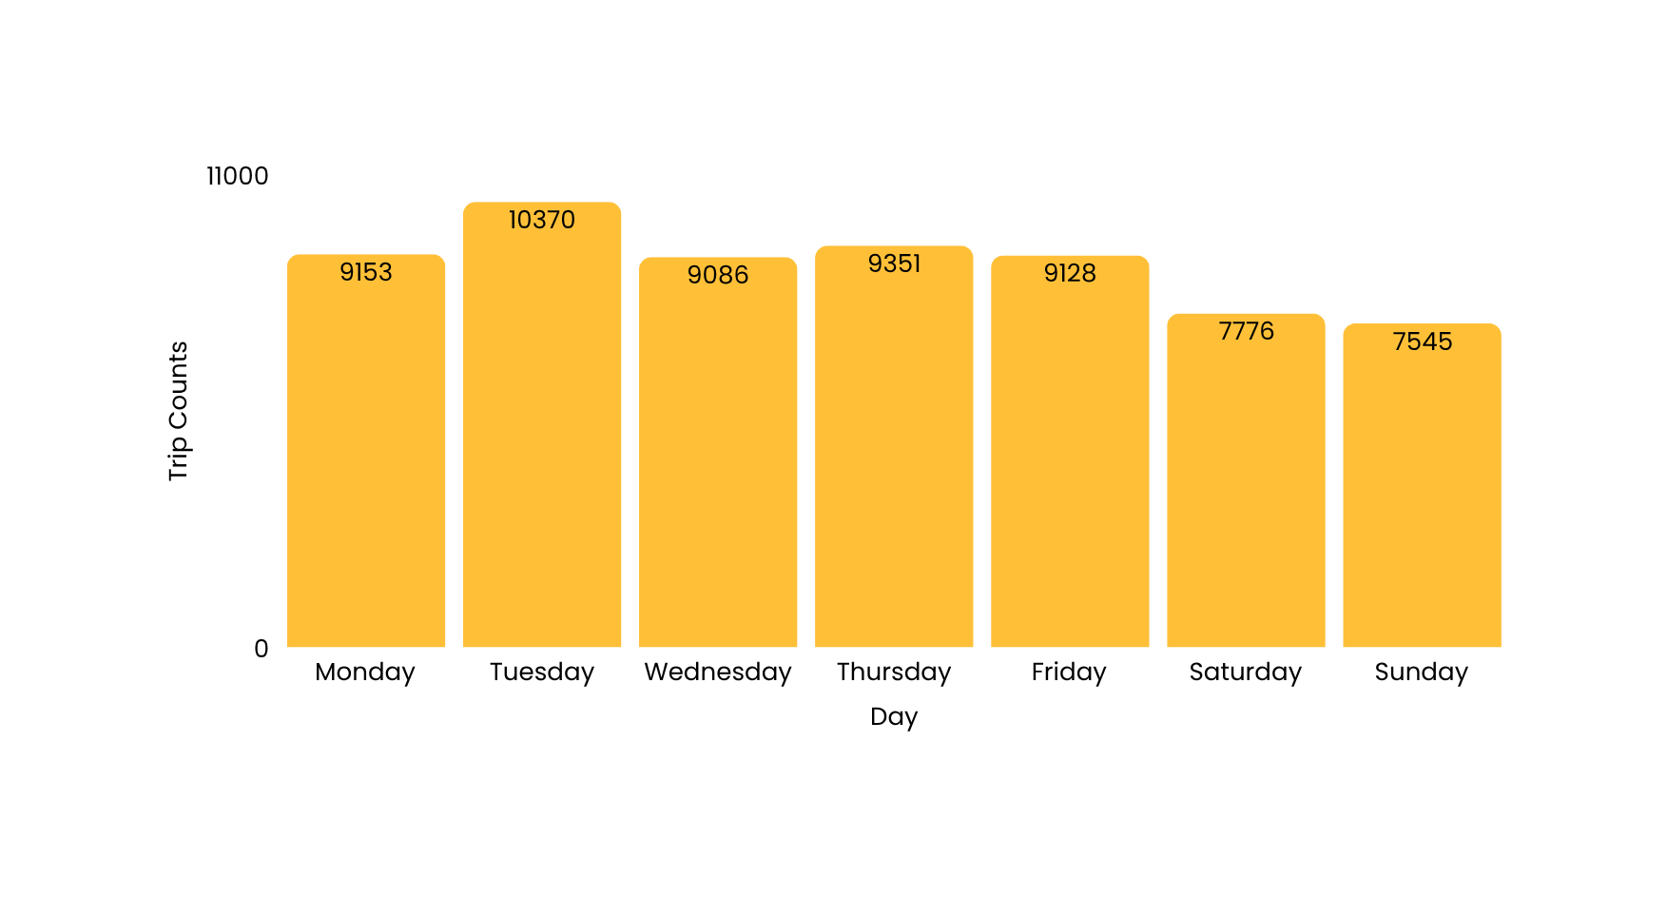
ANALYSIS
Day’s Performances
Tuesday has the highest dropoff counts, while weekends show reduced activity—indicating a need for optimized weekday allocation and potential weekend incentives.
8

Slide 12
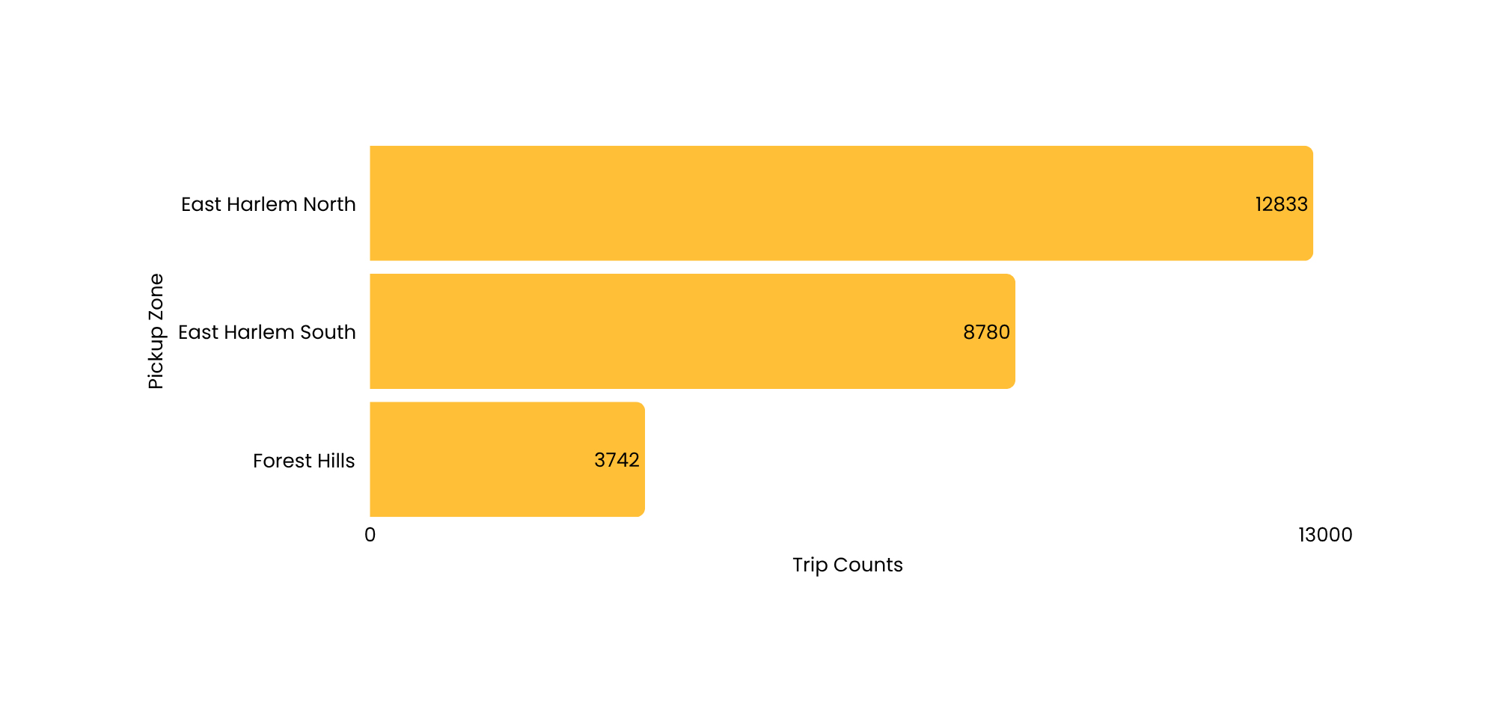
ANALYSIS
Busiest Pickup Zone
Top zones like East Harlem North and South show consistently high demand. Prioritizing fleet deployment in these areas can significantly improve service efficiency and revenue.
9

Slide 13
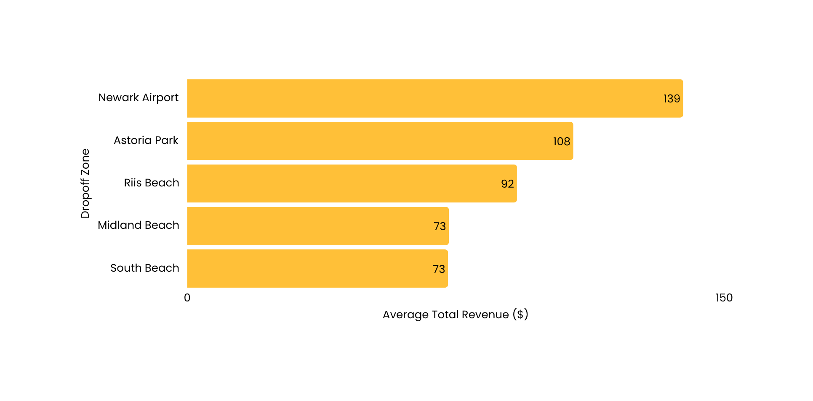
ANALYSIS
Highest Quality Dropoff Zones
High-value drop-off zones such as Newark Airport and Astoria Park suggest targeted pricing or premium service strategies.
10

Slide 14
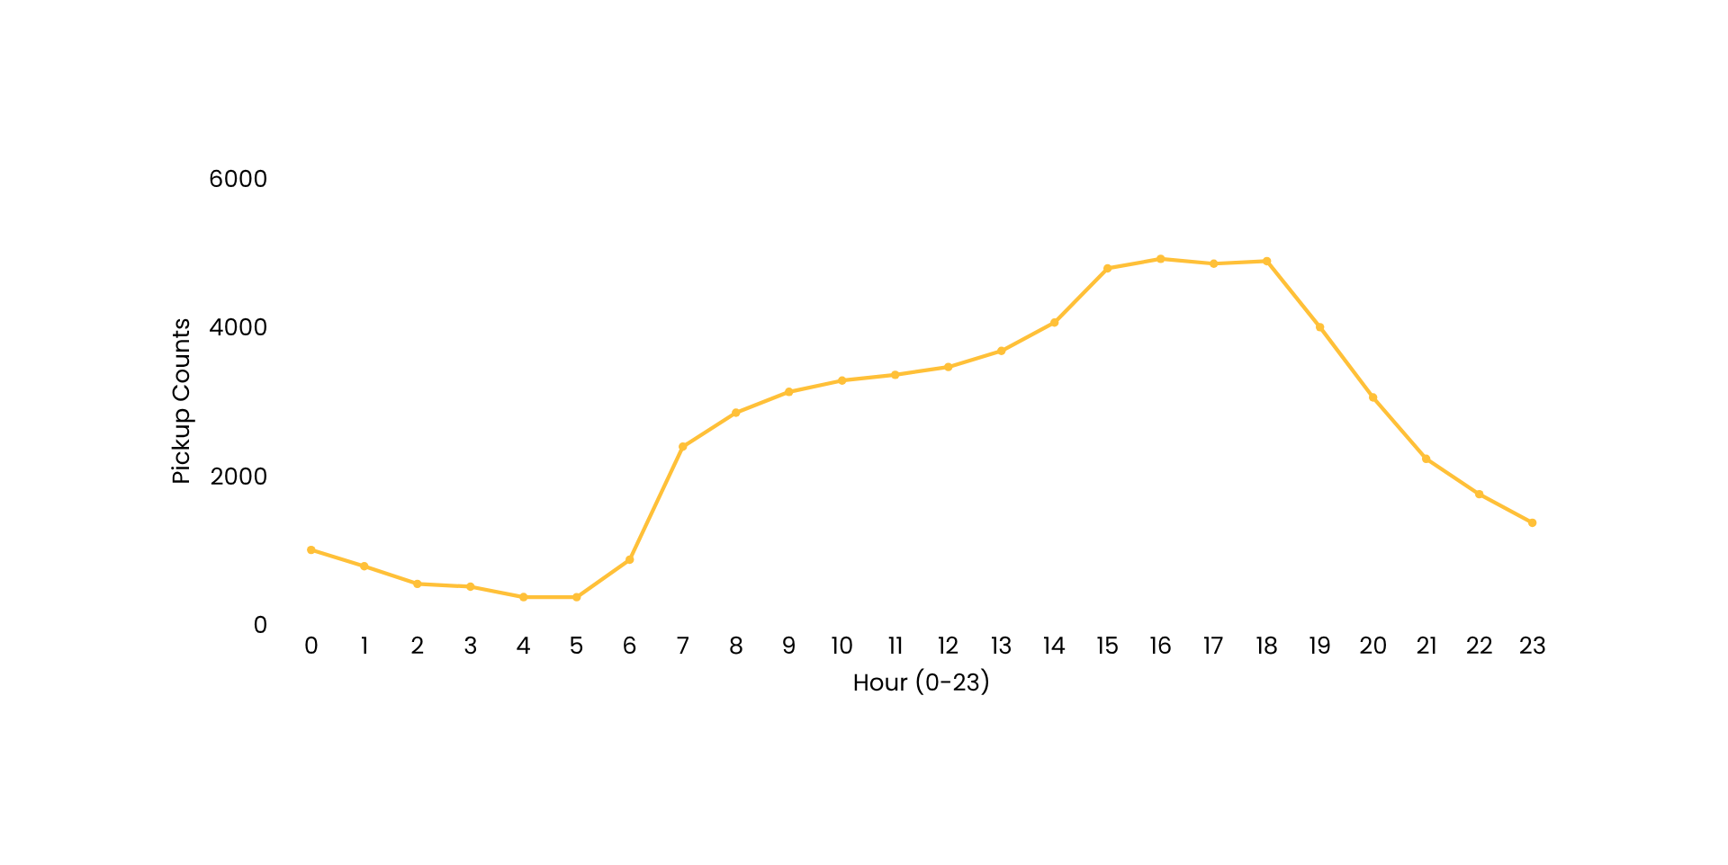
ANALYSIS
Pickup Hour Trend
Peak pickups occur at 4 PM, suggesting high demand during afternoon hours—ideal for focused fleet deployment. Very low activity occurs between 12–6 AM.
4911
11

Slide 15
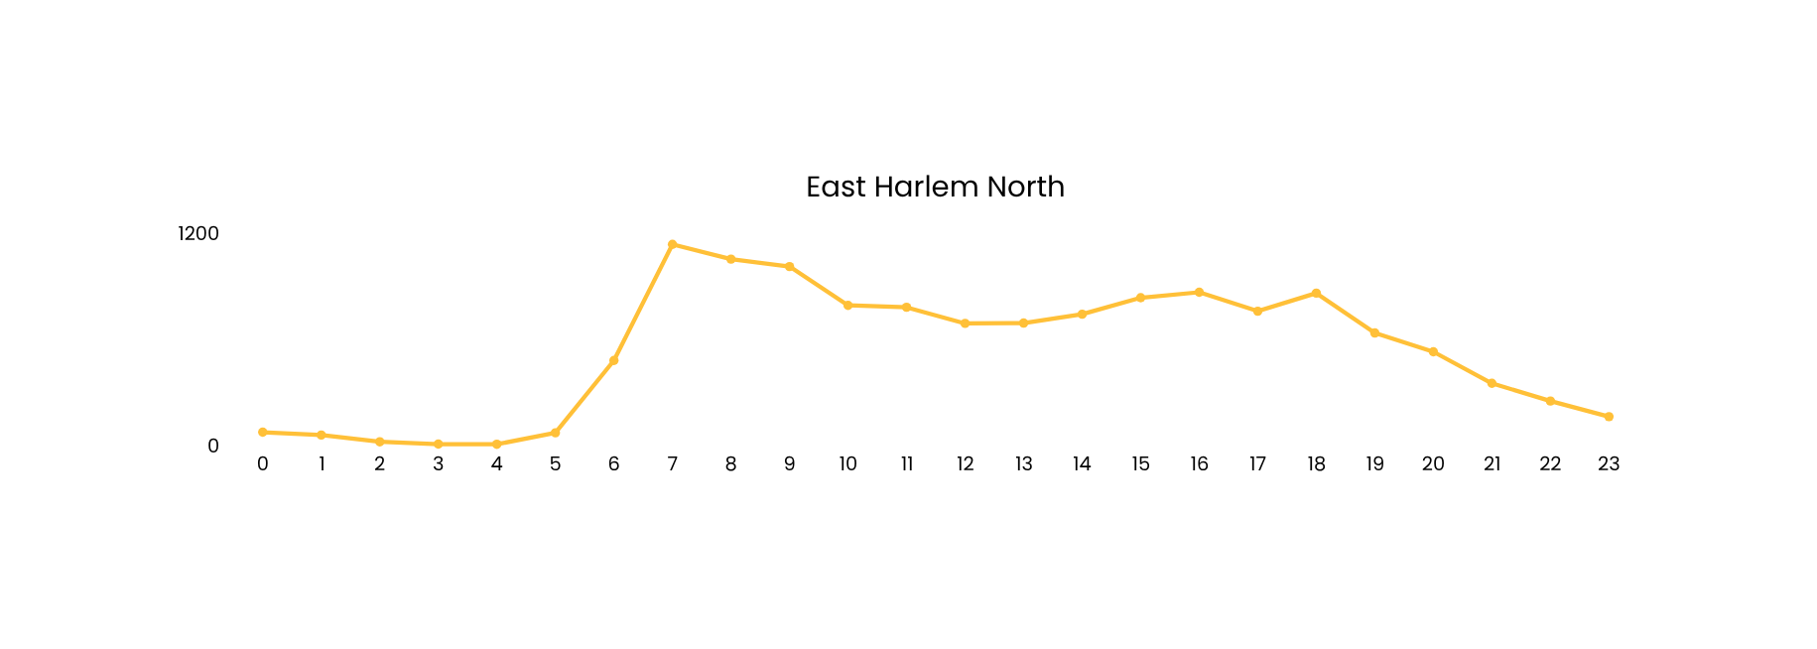
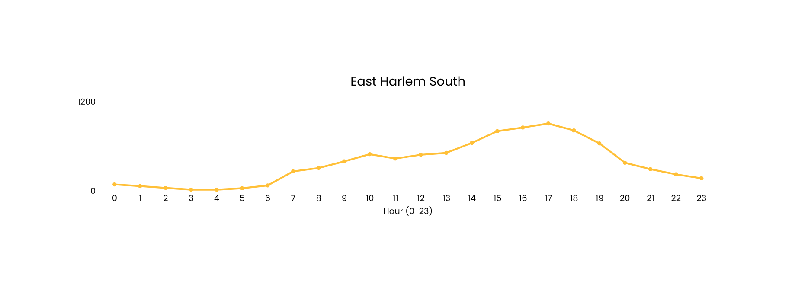
ANALYSIS
Pickup Hour Trend at East Harlem
Pickup activity peaks at 7 AM in East Harlem North and 4–5 PM in East Harlem South, while both zones show very low demand during midnight to early morning (00:00–05:00).
1134
Pickup counts
902
12

Slide 16
BUSINESS RECOMMENDATIONS

Slide 17

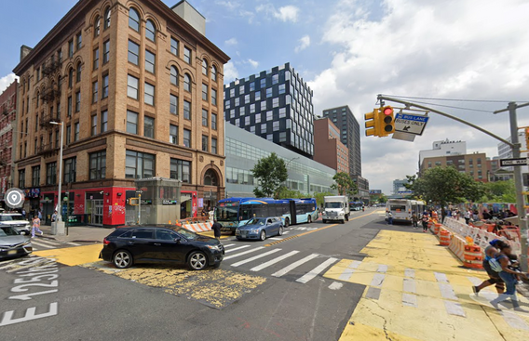
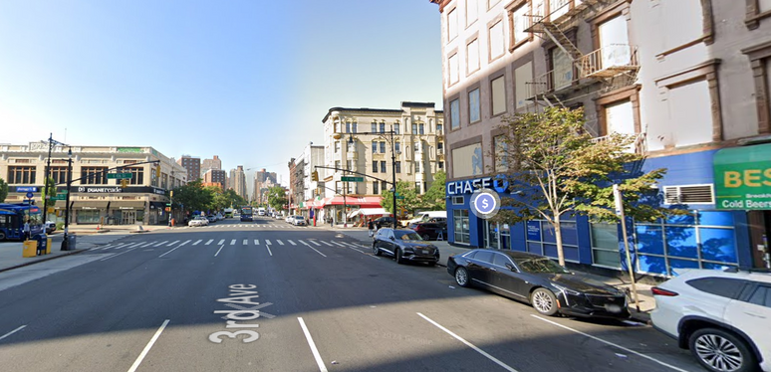

BUSINESS RECOMMENDATIONS
Optimize Fleet Allocation in High-Demand Zones
East Harlem North
East Harlem South
Deploy +10% additional vehicles during peak hours (7 AM). Relocate fleets from East Harlem South or neighboring zones(e.g. Randalls Island & Mott Haven)
Deploy +10% additional vehicles during peak hours (4–6 PM). Relocate fleets from East Harlem North or neighboring zones(e.g. Yorkville & Upper East Side)
13

Slide 18


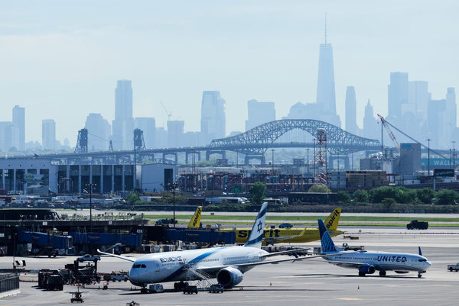

BUSINESS RECOMMENDATIONS
Introduce Premium Zones with High Revenue Potential
Dropoff Zone with:
average revenue > $30
trip duration > 30 minutes
&
Astoria Park
Premium Zone
Implement a modest 3–7% fare increase balanced with value-added perks such as $1 ride vouchers or complimentary snacks to boost rider satisfaction for the premium zone trips.
Pilot Duration: 2–4 weeks → Monitor impact on revenue and passenger retention.
Newark Airport
14
Riis Beach

Slide 19

BUSINESS RECOMMENDATIONS
Encourage Off-Peak Travel with Incentives
early morning trips (00.00 - 05.00)
weekend trips
Discounts or small rewards
15

Slide 20
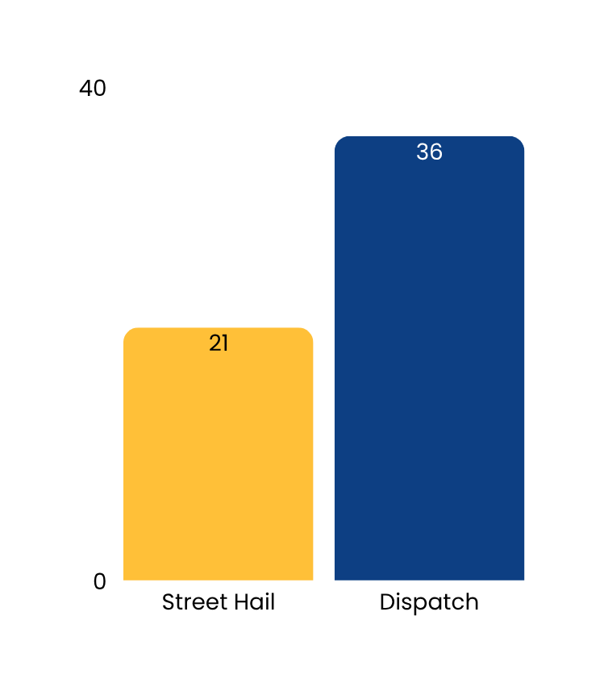
BUSINESS RECOMMENDATIONS
Future Outlook: Unlocking Dispatch Potential
With dispatch trips generating significantly higher revenue, we propose developing an integrated Dispatch App to:
Track real-time fleet & availability
Provide fare estimates & enable digital payments
Enable pre-booking based on premium zone trends
This innovation will also help optimize fleet allocation, minimize passenger wait times, and deliver a more efficient, data-driven transportation system.
16

Slide 21



THANK YOU
For Attending Our Presentation
Contact Us For More Information
alfcvean
Alfriando C Vean
alfriandocv@gmail.com

